Slide 1
INKSTER

Slide 2
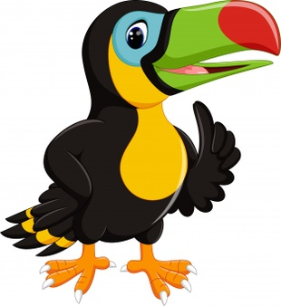
TOUCANS

Slide 3
PELICANS

Slide 4
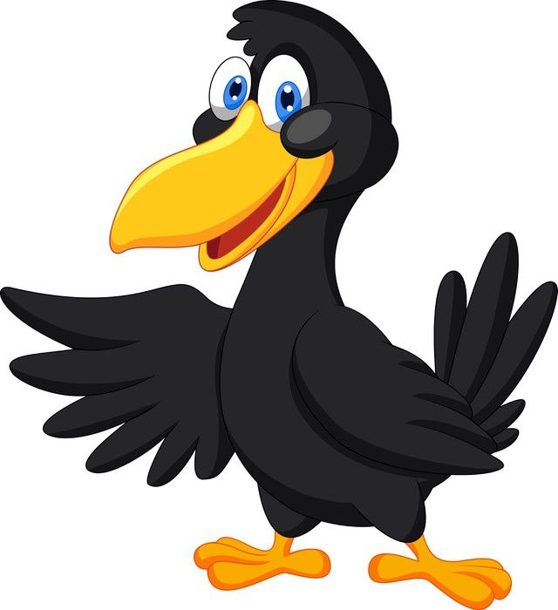
RAVENS

Slide 5
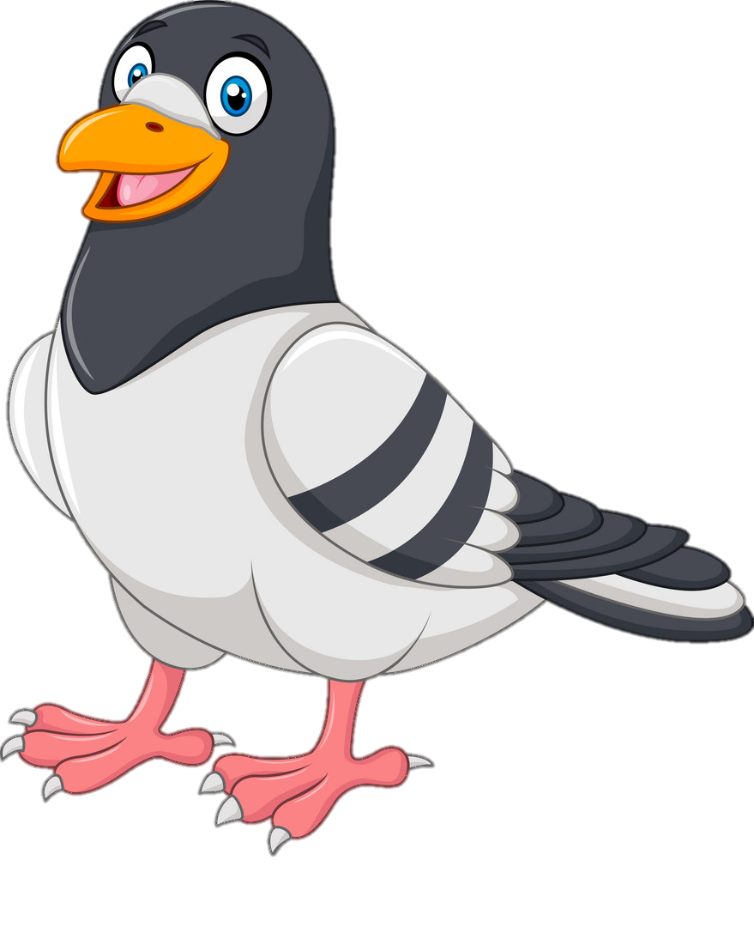
PIGEONS

Slide 6
DETROIT

Slide 7
DUCKLINGS

Slide 8
PENGUINS

Slide 9
PEACOCKS

Slide 10
FLAMINGOS

Slide 11
PARROTS

Slide 12
MS. COCHRANE
MRS. BROADNAX
MS. JONES
MRS. CONLEY
MS. JONES
MS. DOSS

Slide 13
MS. WHITEHEAD
MS. ROBINSON
MS. MILES
MS. PETERSON
MS. MILES
MS. PETERSON

Slide 14
SOUTHFIELD

Slide 15
TURKEYS

Slide 16
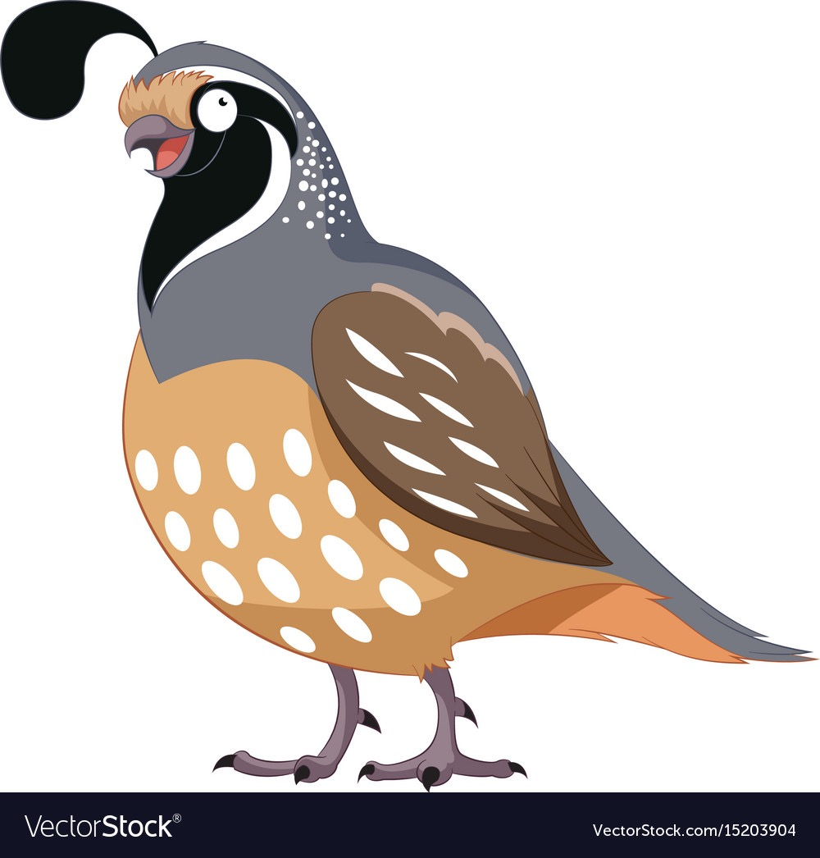
PHEASANTS

Slide 17
HUMMINGBIRDS

Slide 18
BLUEJAYS

Slide 19
MADISON HTS

Slide 20
OWLS

Slide 21
PARAKEETS

Slide 22
SWANS

